Slide 1
LeakyOhm: Secret Bits Extraction using Impedance Analysis
Saleh Khalaj Monfared, Tahoura Mosavirik, Shahin Tajik
Apr 5, 2023
NEHWS 2024

Slide 2


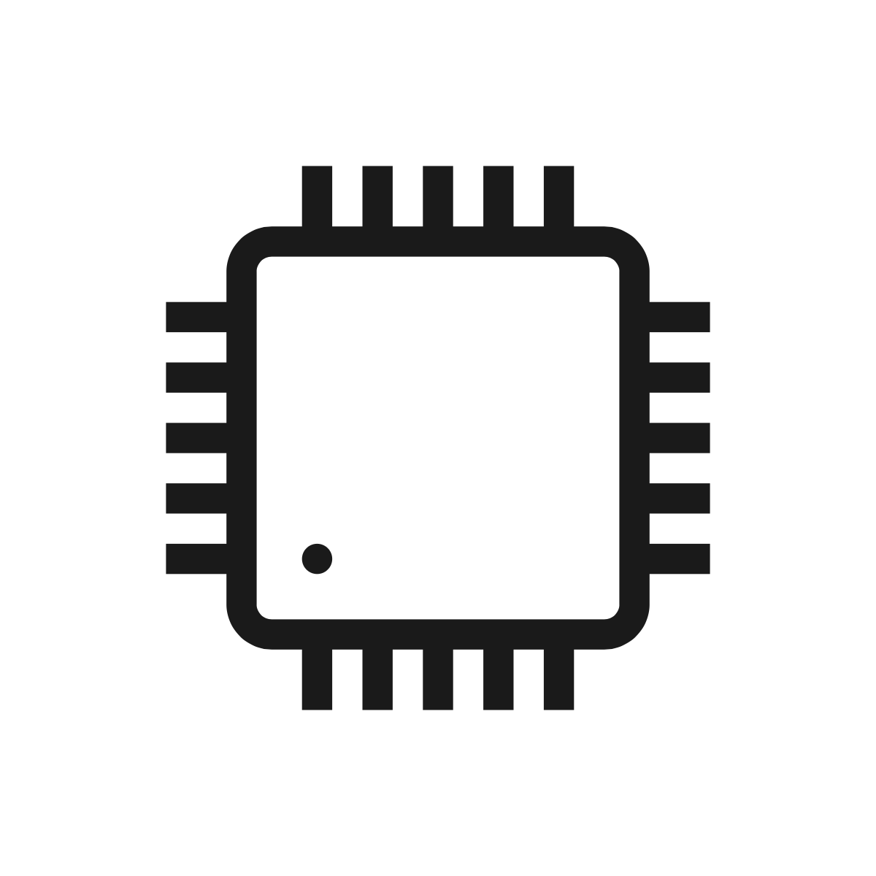







Side-Channel Leakage and Ohm’s Law
Computation is a physical phenomenon
Influence of computation or storage on current or voltage
Research questions:
Does impedance leak information about the state of a circuit?
$$V=ZI$$
$$V=ZI$$
If yes, what would be consequence of it for conventional SCA countermeasures?

Slide 3
A little bit background…

Slide 4
Power Delivery Network (PDN)
Power
Ground
Die
Decap
Decap
Voltage Regulator Module (VRM)
BGA
package
Decoupling Capacitor (Decap)
Decap
Bonding Wires
Balls
Balls
Printed Circuit Board (PCB)
Decap
Decap
Die in QFP Package

Slide 5
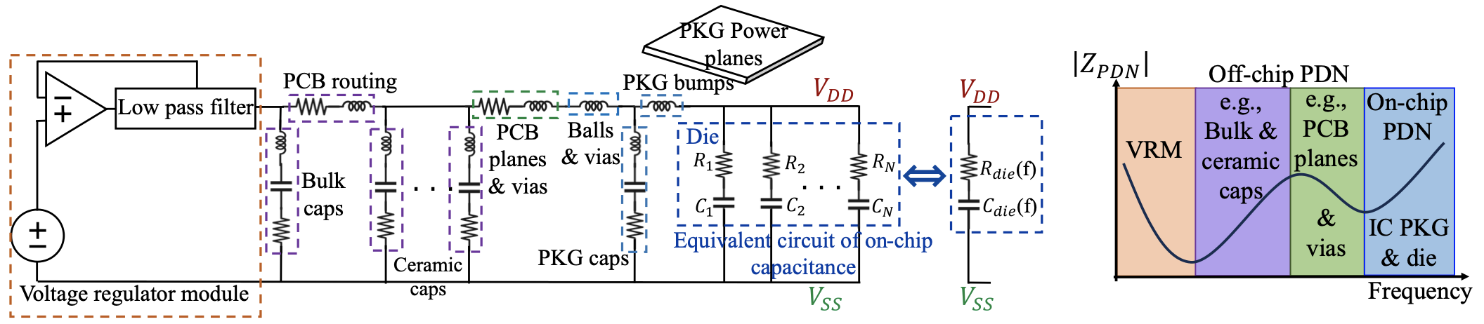
PDN’s Impedance Profile
Equivalent RLC circuit of the system’s PDN
Impedance profile over frequency

Slide 6
On-die PDN’s Impedance Sources

Slide 7
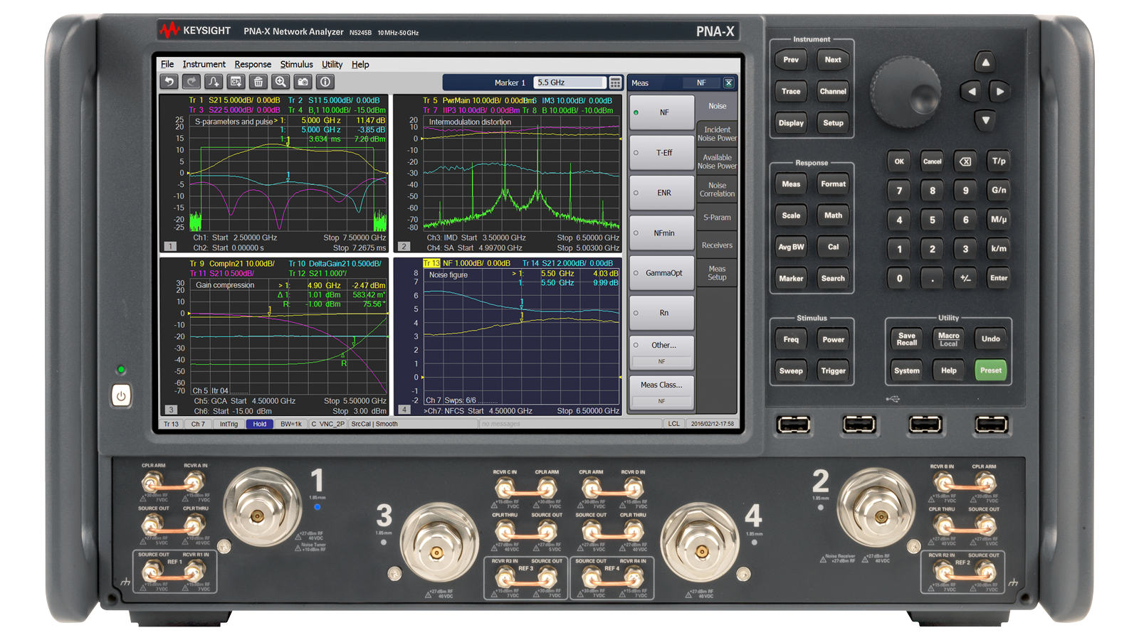
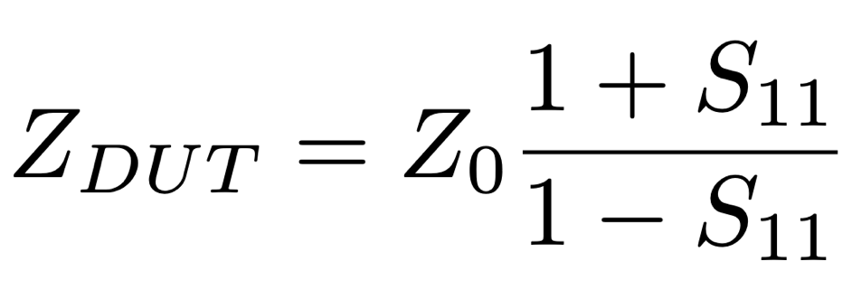
Scattering Parameters
Scattering parameters of a 2-port network
Vector Network Analyzer

Slide 8
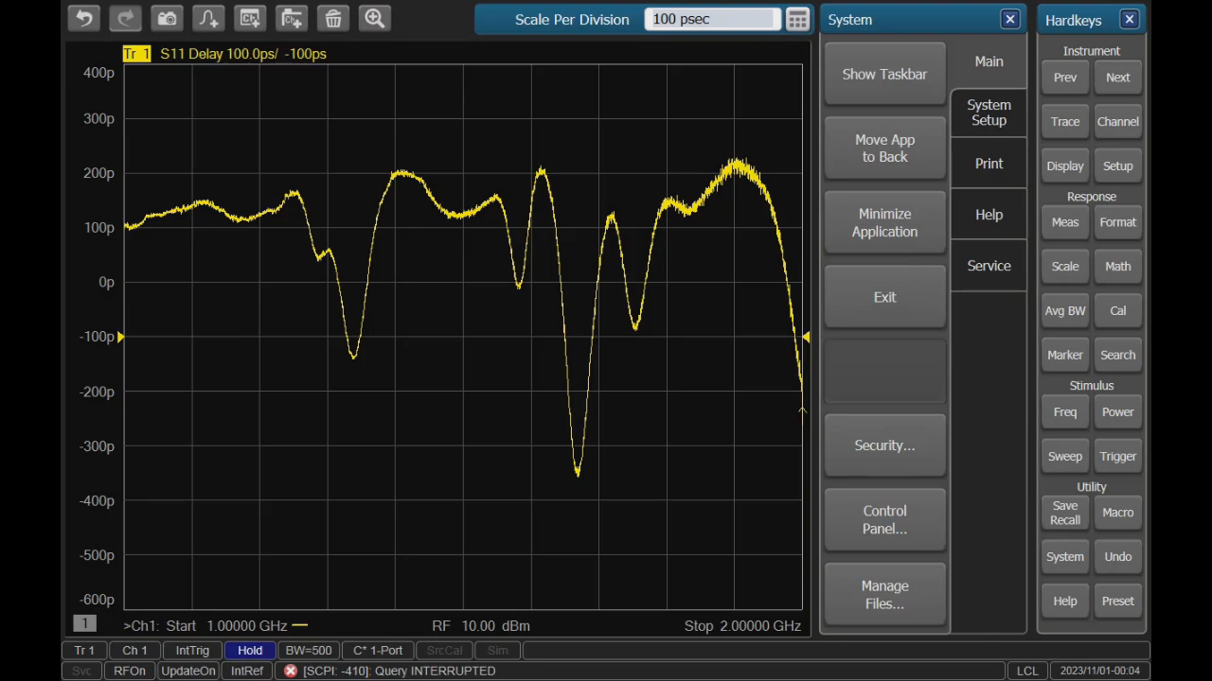
Experimental Setup

Slide 9
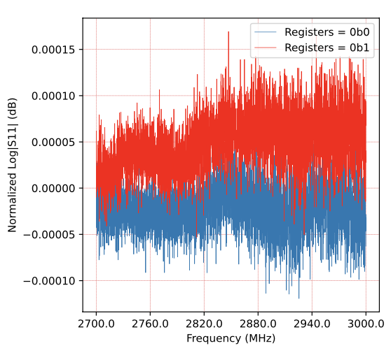
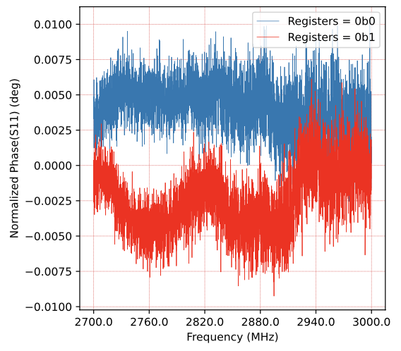

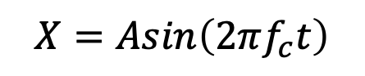
Chip as a Communication/RADAR Channel
Transmitted Signal:
$$X=Asin\left(2πf_{c}t\right)$$
$$\tilde{X}=αAsin\left(2πf_{c}(t−T)+φ\right)+N$$
Received Signal:

Slide 10
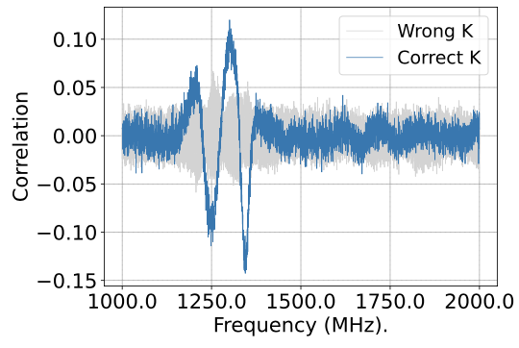
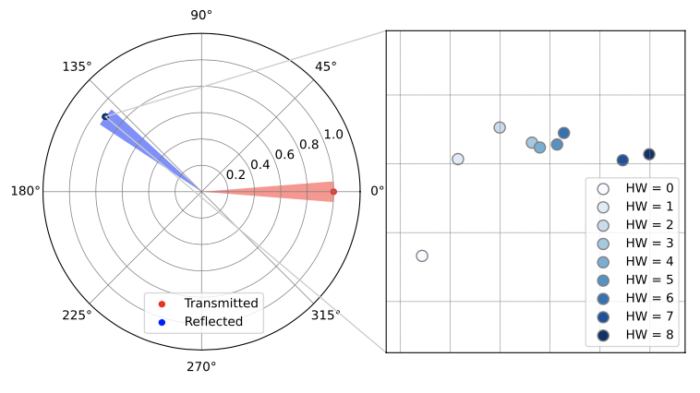
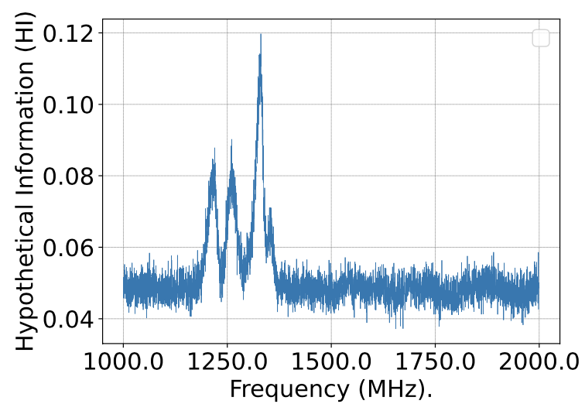
Correlation Impedance Analysis (CIMA)
Naive Correlation Attack on an unprotected AES S-box using HW model
Successful key recovery by running CIMA on 1200 samples at specific frequency points
HW is not necessary the best model

Slide 11
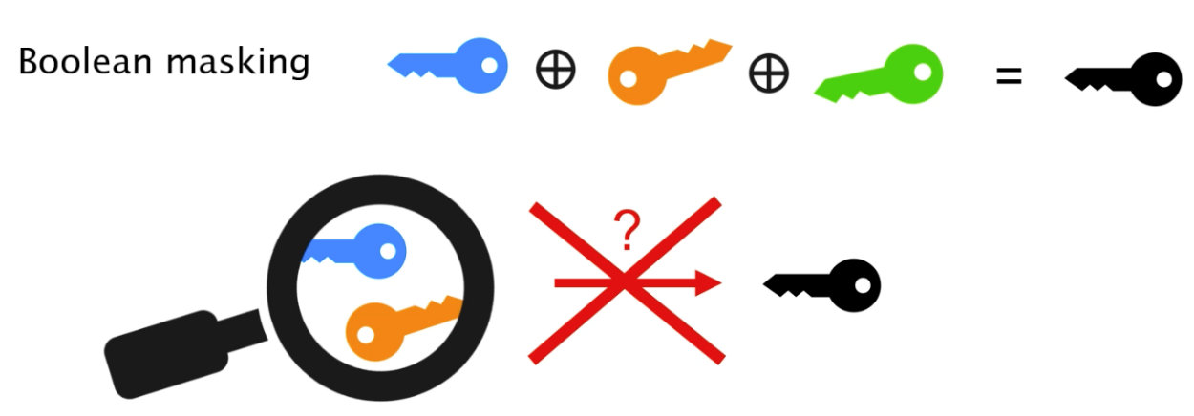
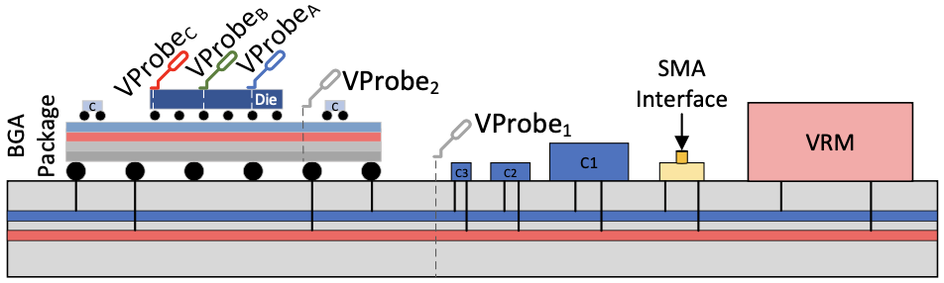
Virtual Probes
Masking: Applying Multiparty Computation and Secret Sharing to algorithms and secrets
Moving your virtual probes on the die by changing the frequency
Directly probing the key shares

Slide 12
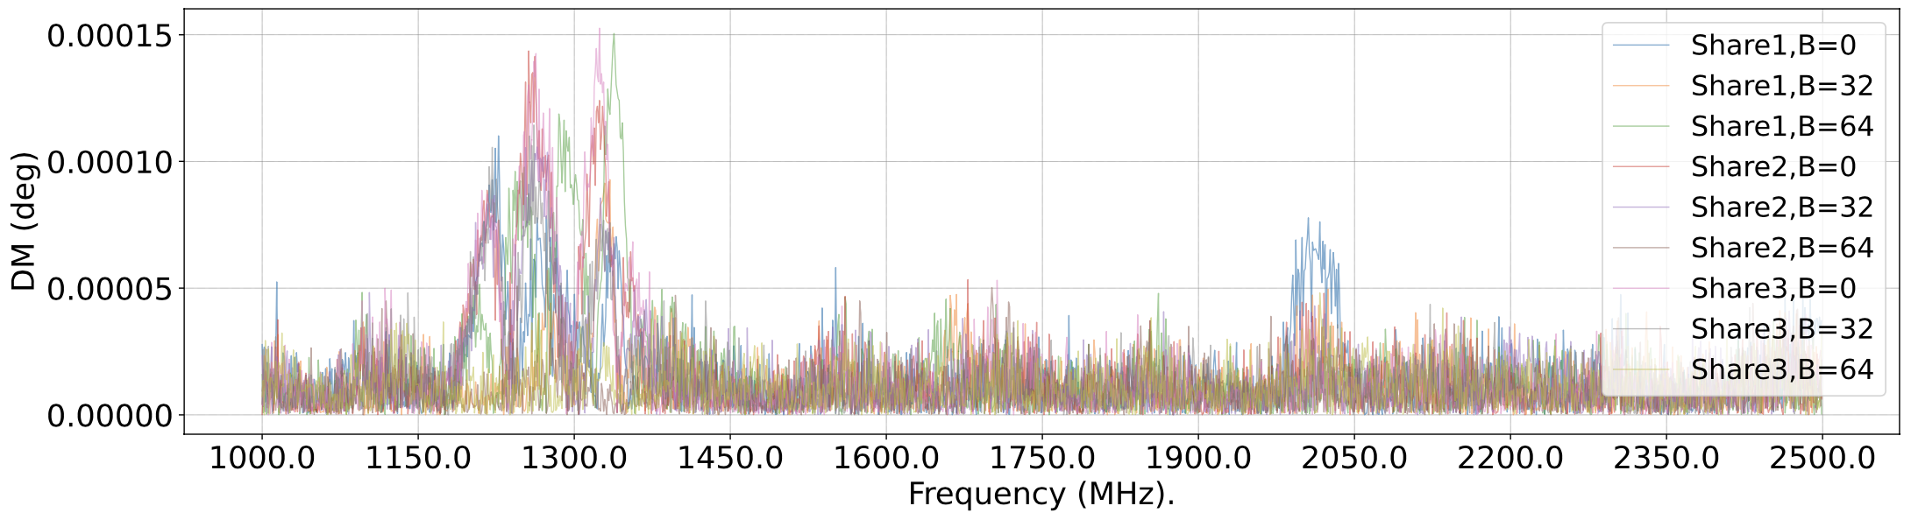
Template Impedance Analysis (TIMA)
Key shares leakage through frequency of 2nd order masked AES-128 implementation using Domain Oriented Masking (DOM)

Slide 13
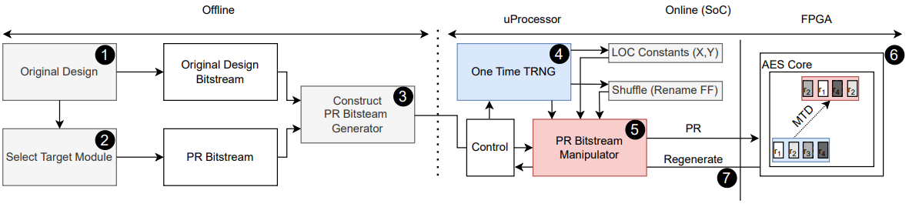
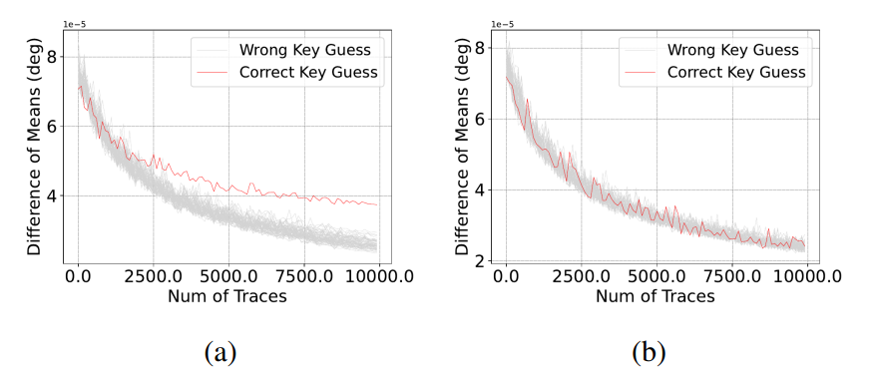
Mitigation: Moving Target Defense

Slide 14
Conclusion
The physical fabric of a computing system is data dependent!
Impedance analysis is an active side-channel: More robust sensing of physical changes on the system through impedance sensing
Leakage of individual bits in various frequency points based on their physical location on the chip
Hiding countermeasures, such as dynamic/partial reconfiguration, is effective against impedance attacks

Slide 15
Thank you!

